Slide 1
SharePoint Framework Extensions: List View Command Set
List View Command Sets

Slide 2

Command Sets
Overview
Debugging & Testing
Deploying
Notes:
In this unit, you'll learn about another type of SharePoint Framework extension that enables adding buttons to a list toolbar and context menu: command sets.

Slide 3
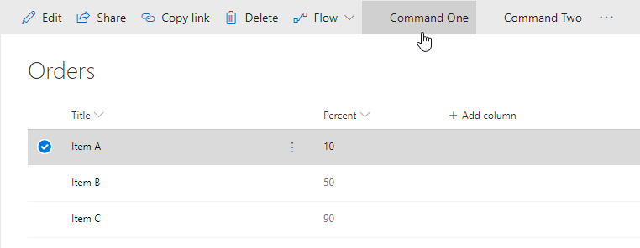
List View Command Sets
Add buttons to modern lists & libraries
Add to toolbar
Add to item context menus
Or both!
Control visibility state of button based on state of view
Similar to pre-SPFx / classic mode customizations
Custom actions
Example scenarios
Start external process
Execute custom script when clicked
Notes:
A SharePoint Framework command set extension enables developers to add buttons to modern lists and library toolbars and context menus.
Each button's visibility state is controlled using a single boolean property that developers can set. This property enables developers to conditionally show or hide buttons from the toolbar or context menus on an item. These command set extensions are similar to the SharePoint classic experience customizations of custom actions. The classic mode custom action customizations don't work in the modern experience and command sets will only work in the modern experience.
The following scenarios are some example use cases for command sets:
- start an external process
- execute custom script when the button is selected
The SharePoint Framework will raise an event whenever the state of the view changes that your custom code can subscribe to. For example, if a user selects or unselects an item or changes a filter on the view, you can conditionally change the state of the button's `visible` property based on how many items are currently selected in the list.

Slide 4
Defining Command Set Buttons
// *.manifest.json
{
"items": {
"ONE_ITEM_SELECTED": {
"title": { "default": "One Item Selected" },
"iconImageUrl": "icons/request.png",
"type": "command"
},
"ALWAYS_ON": {
"title": { "default": "Always On" },
"iconImageUrl": "icons/cancel.png",
"type": "command"
}
}
}
Notes:
Unlike the other types of extensions, you must first register the command set buttons prior to executing the code. Command set registration is done in the component's manifest file. Each button must be added to the `items` collection:
This JSON excerpt from the component manifest registers three buttons. The name of the buttons must be in all caps and only consist of letters and underscores.
Each button reference has a `type` property set to `command` and a `title` property that can be localized to any of the SharePoint Framework supported locales.

Slide 5
Command Set Class
export interface ICommandSetDemoCommandSetProperties {
messagePrefix: string;
}
export default class CommandSetDemoCommandSet
extends BaseListViewCommandSet<ICommandSetDemoCommandSetProperties> {
@override
public onInit(): Promise<void> {
}
@override
public onListViewUpdated(event: IListViewCommandSetListViewUpdatedParameters): void {
// fired when state of list view changes
}
@override
public onExecute(event: IListViewCommandSetExecuteEventParameters): void {
// what happens when button is selected
}
}
Notes:
After registering the buttons, you must create a class who's implementation is similar to the other other SharePoint Framework extension options.
An interface is used to define the public properties that can be set as inputs on the extension.
Next, implement a class that extends the `BaseListViewCommandSet` base class and override the implementation of three methods:
The `onInit()` method returns a `Promise` object and can be used to perform any initialization code that needs to be completed before rendering the command set.
Next, implement the `onListViewUpdated()` event. This method is called when the command set button is first rendered on the page and when the list view state changes. Each button rendered on the page will call this method, so if you have registered three buttons in your component's manifest, this method will be called three times every time the list view state changes.
The last step is to implement the `onExecute()` event that is called when a button is selected by the user. Similar to the `onListViewUpdated()` event, this is method is shared among all the buttons registered in your component's manifest. You can use the `itemId` property on the `IListViewCommandSetExecuteEventParameters` object passed into the `onExecute()` to determine which button triggered the click event.

Slide 6
Debugging & Testing Command Sets
The SharePoint workbench doesn't support testing extensions
Can still build and host extension project locally while testing in a remote SharePoint site
Configurations added to each project by the SPFx Yeoman generator simplifying loading SharePoint sites
Notes:
Now let's look at how you can debug and test SharePoint Framework command set extensions. The SharePoint workbench doesn't support testing extensions. However, you can still build and host extensions projects locally while debugging and testing in a remote SharePoint site.
To test a command set extension, you include special query string parameters to the URL of a live SharePoint modern page, list, or library. These parameters instruct SharePoint to do the following things:
- load the SharePoint Framework on the page if it isn't already present
- the location of the **manifest.js** file from the local web server that tells SharePoint what custom components can be put on the page
- which component the SharePoint Framework should load and put on the page
- additional properties specific to each component
The Yeoman generator for the SharePoint Framework simplifies this process fo you by creating a configuration that the **gulp serve** task uses to create the debugging URL. These settings are defined in the **./config/serve.json** file.
When SharePoint receives the request with these query string parameters, it will first prompt the user to confirm they want to load debugging scripts. SharePoint does this same technique could be used in a phishing attack. Therefore, you should only load the debugging scripts if you're sure you started the request.

Slide 7
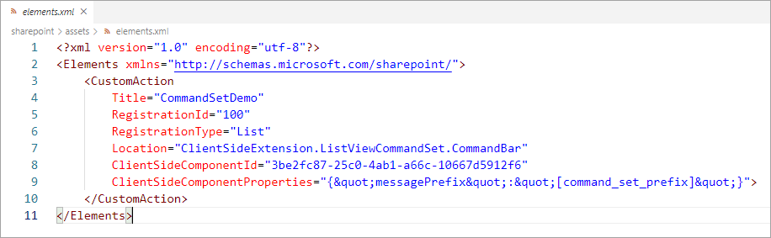
Deployment
Extension deployment utilizes SharePoint Feature framework
Command set buttons provisioned using a custom action defined in elements.xml
Deployment similar to web parts
Upload SharePoint Package to tenant / site collection app catalog
Install app
Notes:
The deployment of command set extensions is similar to other types of SharePoint Frameworks extensions.
When tenant wide deployment isn't enabled for the deployed package, the SharePoint Feature framework is used to provision command set buttons into a SharePoint environment using a custom action. The custom action is defined in **./sharepoint/assets/elements.xml** file.

Slide 8
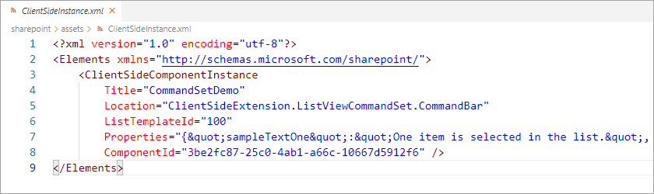
Deployment – Tenant Wide
Command set extensions support tenant wide deployment
Tenant wide deployment process uses the ClientSideInstance.xml file
Command set: <ClientSideComponentInstance>
Entry added to the Tenant Wide Extensions list in the tenant’s app catalog site
Notes:
SharePoint Framework command set extensions, like application customizers, support tenant wide deployment. When tenant wide deployment is enabled for the deployed package, the deployment process uses the **ClientSideInstance.xml** file within your SharePoint package to add an entry to the **Tenant Wide Extensions** list in the tenant's **App Catalog** site. The **ClientSideInstance.xml** file can be found in the **./sharepoint/assets** folder in your project.

Slide 9
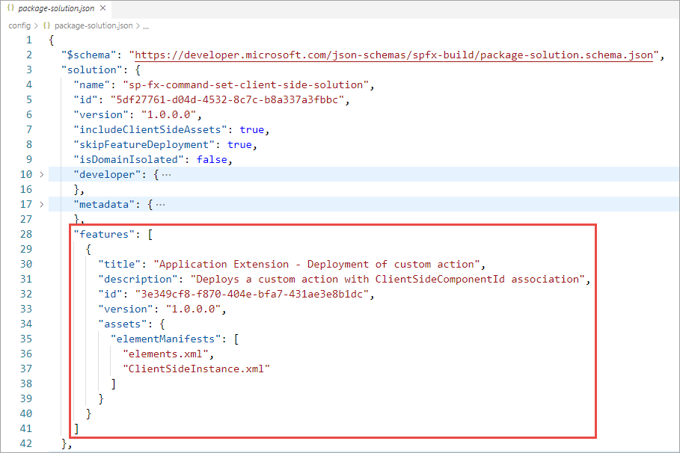
Deployment – Feature
ClientSideInstance.xml and elements.xml are elements of a Feature
Feature definition part of solution object in package-solution.json
Notes:
SharePoint Framework command set extensions, like application customizers, support tenant wide deployment. When tenant wide deployment is enabled for the deployed package, the deployment process uses the **ClientSideInstance.xml** file within your SharePoint package to add an entry to the **Tenant Wide Extensions** list in the tenant's **App Catalog** site. The **ClientSideInstance.xml** file can be found in the **./sharepoint/assets** folder in your project.

Slide 10
Demo Creating SharePoint Framework List View Command Sets

Slide 11

Summary
Overview
Debugging & Testing
Deploying

Slide 12
Reading further
Overview of the SharePoint Framework
https://docs.microsoft.com/sharepoint/dev/spfx/sharepoint-framework-overview
Overview of SharePoint Framework Extensions
https://docs.microsoft.com/sharepoint/dev/spfx/extensions/overview-extensions
Build your First ListView Command Set extension
https://docs.microsoft.com/en-us/sharepoint/dev/spfx/extensions/get-started/building-simple-cmdset-with-dialog-api

Slide 13
Thank you.

